Slide 1
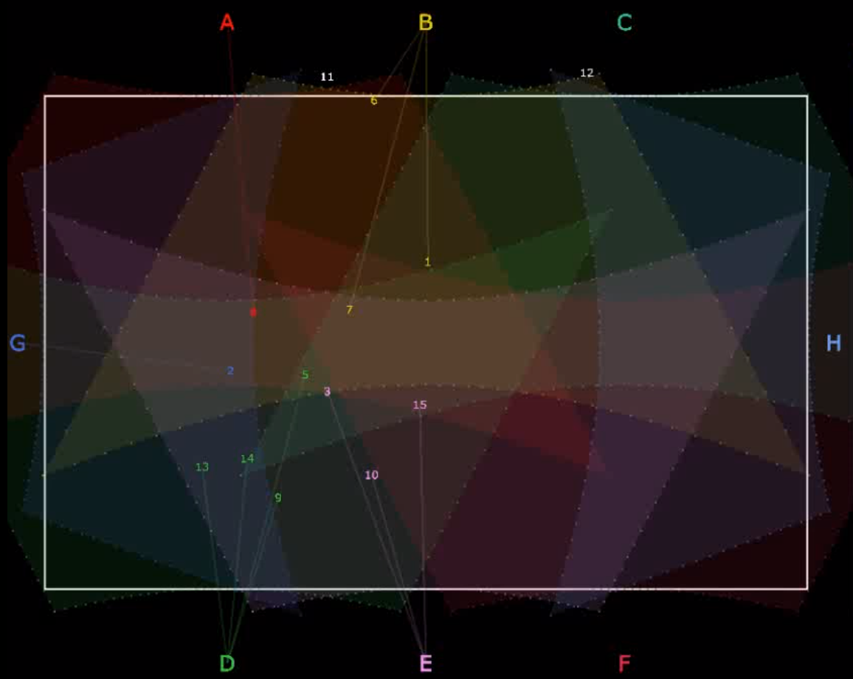
OPTIMAL LASER SYSTEM FOR MOTION ILLUMINATION
H2020 SOCIETAL CHALLENGES: Include the more appropriated challenge
PRODUCTIVE SECTOR: Sport, training, performance
PROBLEM DESCRIPTION
Training in many sports includes the practice of harmonized strategic movements. The laser system aims to illuminate dynamic paths of the players.
MATHEMATICAL AND COMPUTATIONAL METHODS
First, the optimal number and location of the lasers are determined modelling the problem as a rectangle covering problem, resulting in a Mixed Integer Linear Programming problem. In order to solve this hard problem, a constraint generation approach is developed, that can solve any real-size problems. Next, for a given dataset describing the dynamic paths of the players the assignment of players to lasers have to be determined, such that the brightness of each point satisfy the visibility constraints. This assignment can be seen as an online problem, as each assignment and illumination have to be done in milliseconds.
CHALLENGES
AND GOALS
Find the optimal number and placement of the lasers, and the best possible assignment of the players to the lasers, such that in minimal cost the illumination is feasible and satisfies the visibility constraints.
8 lasers with their area of illumination and the assignment of 12 players to the lasers.

Slide 2
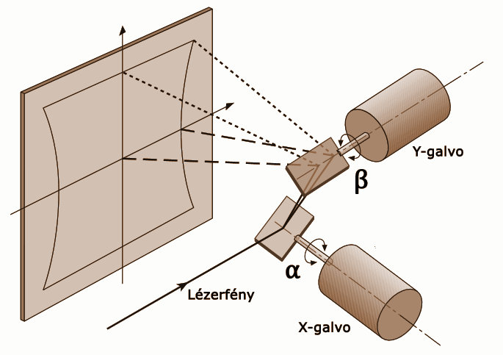
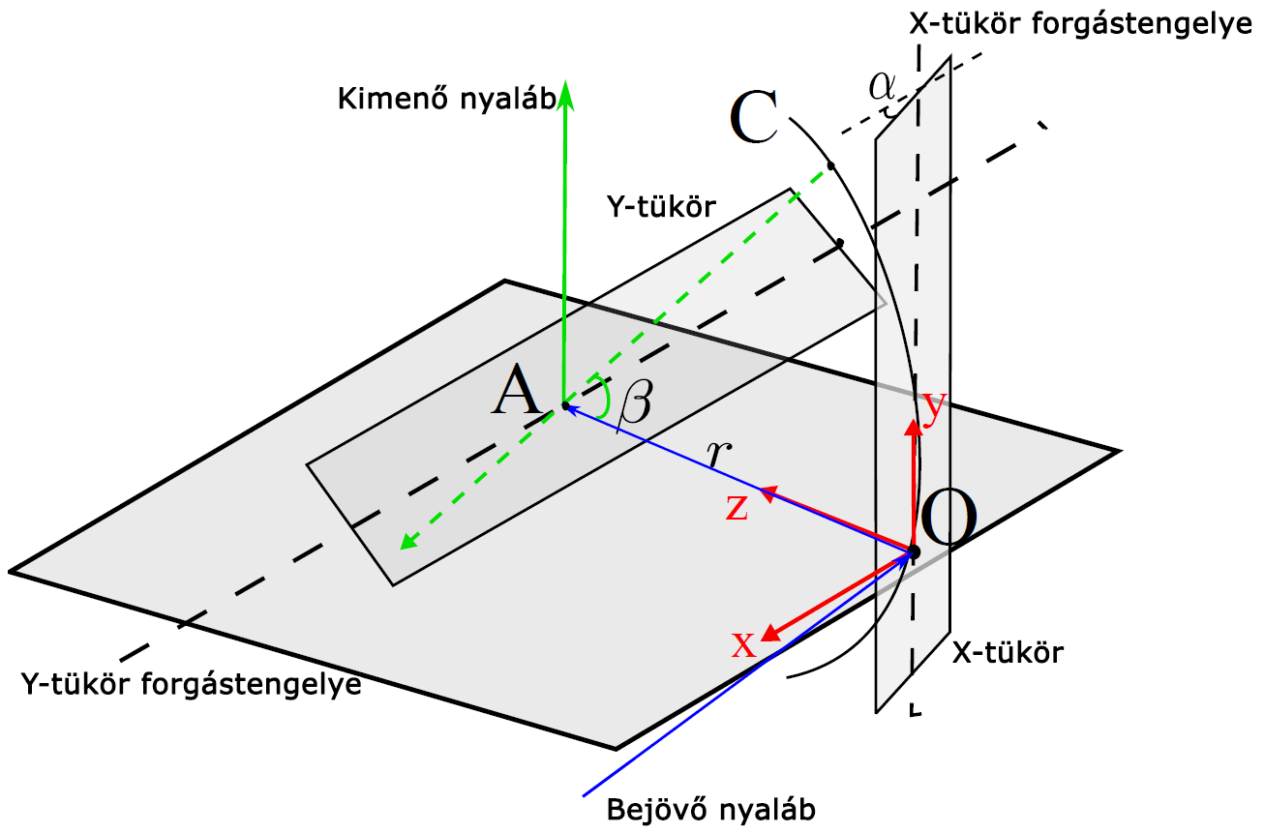
Results and Benefits
OPTIMAL LASER SYSTEM FOR MOTION ILLUMINATION
A Mixed Integer Linear Programming model, including a constraint generation approach is developed to solve the real-life location problem of the lasers minimizing the cost of the system.
The assignment of players to lasers to be illuminated by is done by heuristic procedures, maximizing the minimum brightness of the illuminated points. The control of the laser beam is done by a two-mirror scanner, through a digital-analog converter, which is controlled by the developed program.
Possibility to control a laser system is proven, optimal locations of the laser units can be computed, and optimal brightness of the illuminated points is satisfied.
Two-mirror scanner
Brief description of the image
Digital
Twin
Bem 15 Kft.
Hungarian Service Network for Mathematics
in Industry and Innovations

