Slide 1
Vaccination strategies for varicella in Hungary
HU-MATHS-IN
H2020 SOCIETAL CHALLENGES
Health, demographic change and wellbeing
The Industrial Problem
Varicella Zoster Virus (VZV) causes chickenpox typically in children, and herpes zoster in adults (reactivation of the latent virus). Infections can be effectively prevented by vaccine. In Hungary, varicella vaccination into the mandatory schedule incorporated in 2019.
Public health, epidemiology
Mathematical Epidemiology
Mathematical study and computer simulations in mathematical epidemiology. Delay and hybrid models, networks.
Research group
Epidelay Group
Bolyai Institute
Hungarian National Center
of Public Health
Hungarian national headquarter of public health.
Company

Slide 2
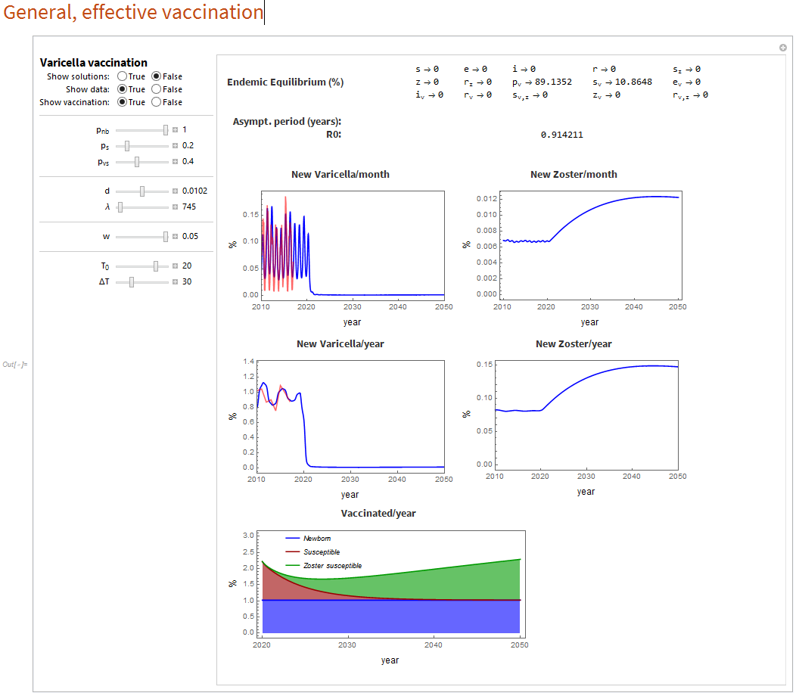
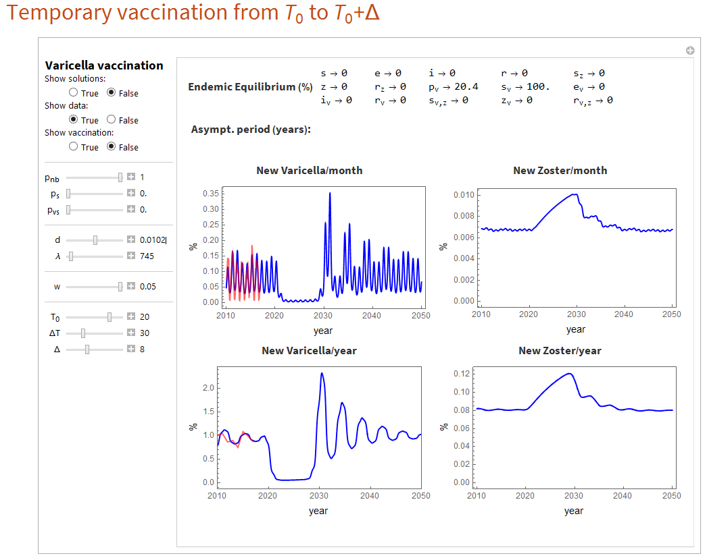
¹
HU-MATHS-IN
Vaccination strategies for varicella in Hungary
Challenges & Goals
• Incorporate vaccination strategies in hybrid age-structured model, and assess:
• the impact of vaccination on the incidence of varicella and zoster
• indirect effects: the impact of exogenous boosting on zoster incidence, age shift in varicella cases.
• the effect of various vaccination strategies and their cost-effectiveness.
Dynamic simulations of vaccination: an effective and a temporary case.

Slide 3
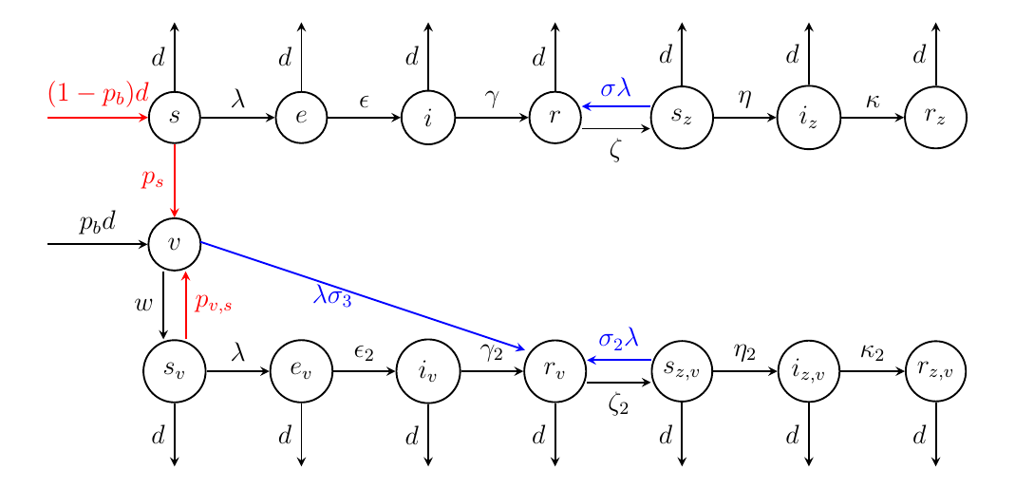
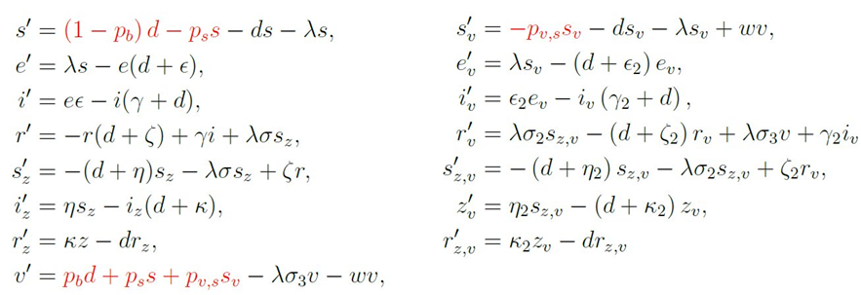
Vaccination strategies for varicella in Hungary
HU-MATHS-IN
Mathematical and computational methods and techniques applied
Construction of a state-of-the-art transmission model that is the most realistic, by incorporating age structure, contact patterns, maternal antibodies, vaccine efficacy and waning, exogenous boosting.
Programming framework to generate and handle large compartmental systems (Wolfram Mathematica)
Combination of analytical (compartmental models, nonlinear impulsive systems, next generation operator, spectral analysis), statistical, numerical, computational (e.g. fitting, sensitivity, optimization …), as well as epidemiological and simulation tools.
The transmission scheme and „master” equation of an age group. Moving from one group to the next one is annually impulsive; Force of infection (λ) contains the interaction (infection) between different groups.

Slide 4
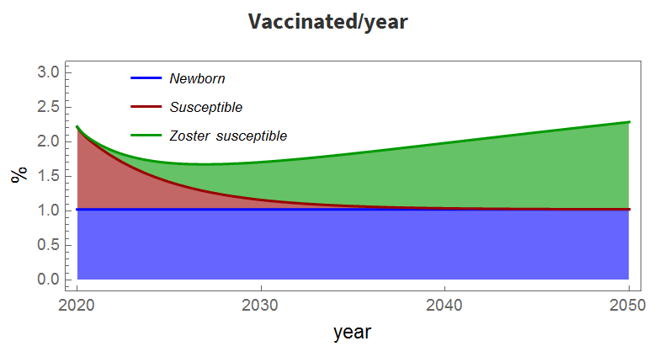
Vaccination strategies for varicella in Hungary
HU-MATHS-IN
Results & Benefits to the company
General framework of age-structured models of infectious disease
Scientific and results against the vaccination of Varicella-Zoster Virus.
Finding optimal vaccination strategies.
Finding key factors to decrease the basic and control reproduction numbers.
Emphasizing the importance of underreporting.
The results help to make scientific, evidence-based decisions in optimizing the routine varicella vaccinations in Hungary, affecting the whole population and billions of HUFs.
An effective comprehensive vaccination
Digital
Twin
The National Center of Public Health receives dynamic modeling tools and analysis of vaccination strategies.

