Slide 1
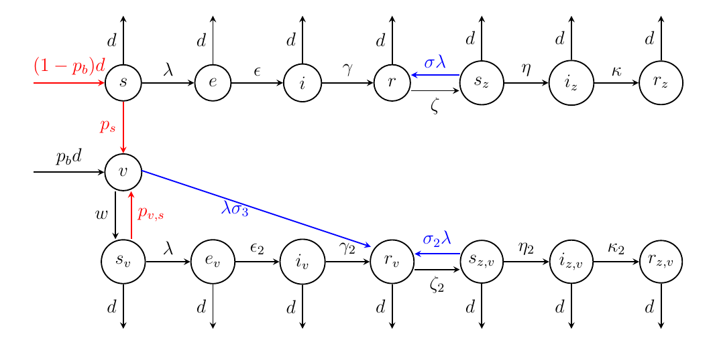
Vaccination strategies for varicella
in Hungary
H2020 SOCIETAL CHALLENGES: Health, demographic change and wellbeing
PRODUCTIVE SECTOR: Public Healt Care
Problem description
Varicella Zoster Virus (VZV) causes chickenpox typically in children, and herpes zoster in adults (reactivation of the latent virus). Infections can be effectively prevented by vaccine. In Hungary, varicella vaccination into the mandatory schedule incorporated in 2019.
MATHEMATICAL AND COMPUTATIONAL METHODS
We develop a dynamic transmission population-based hybrid age-structured model using demographic and epidemiological data for Hungary, (potentially hundreds of coupled nonlinear differential equations with impulses), and employ it with an empirically derived contact matrix. We analyze various scenarios under different assumptions regarding exogenous boosting, vaccine waning, vaccine efficacy, vaccination coverage, risk of complications, age-specific vaccination and contact matrices.
The basic and the control reproduction numbers are key concepts in mathematical epidemiology. Here we propose to generalize this concept to hybrid systems, and study the threshold dynamics separating eradication and persistence of the disease.
ChallengeS
and goals
Incorporate vaccination strategies in a new hybrid age-structured model to assess:
the impact of vaccination on the incidence of varicella and zoster in Hungary
indirect effects: the impact of exogenous boosting on zoster incidence, age shift in varicella cases.
the effect of various vaccination strategies.
The basic model with vaccination, describing each age groups:
Some parameters (death and vaccinations!) have different values in different groups;
Moving from one group to the next one is annually impulsive;
Force of infection (λ) contains the interaction between different groups.

Slide 2
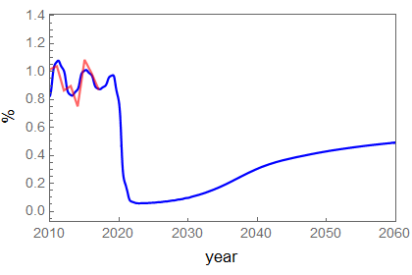
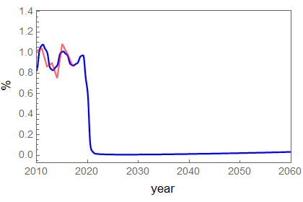
Results and Benefits
Vaccination strategies for varicella
in Hungary
We have developed dynamic modelling framework to handle large hybrid models and to investigate different vaccination strategies. We have fitted our models to the available data. Theoretical and experimental model studies confirm the hypothesis on exogenous boosting and can give strategic recommendations for appropriate vaccination strategies. Further studies on age-structured model will give refine our results and may help the decision making of the public health administration.
The research group has the mathematical-computational methodology and tools to study large age-structured hybrid models in epidemiology. Modelling the vaccination against Varicella
may support the decision making in public health administration.
New Varicella/year
New Varicella/year
Complete toddle and no adult vaccination immunity waning: 20 years
Complete toddle
and appropriate adult vaccination
immunity waning: 20 years
Digital
Twin
Epidelay Group
Bolyai Institute
HU-MATHS-IN

