Slide 1
Modelling in evidence-based medicine
National Network Logo
The Industrial Problem
Using mathematical tools to investigate problem in medicine, specifically those that can be tackled using large disease registries, such as the Hungarian Myocardial Infarction Registry (HUMIR).
Óbuda University, Physiological Controls Research Center (PhysCon)
Research group
PhysCon works on the interdisciplinary field of biomedical engineering on the physiological modeling, simulation and control domain, efficiently supporting the progress of medical science with knowledge of engineering sciences.
Gottsegen Gyorgy Hungarian Institute of Cardiology
Company
The Gottsegen Hungarian Institute of Cardiology is committed to providing excellence in multidisciplinary, comprehensive, and innovative cardiovascular care.

Slide 2
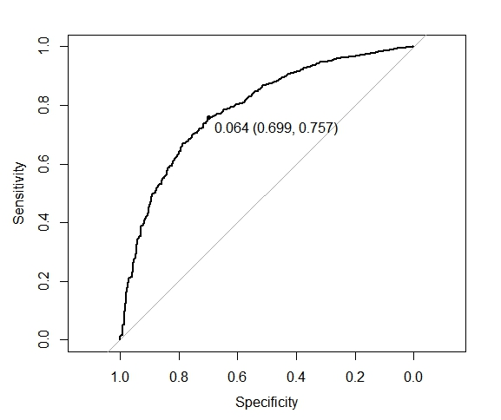
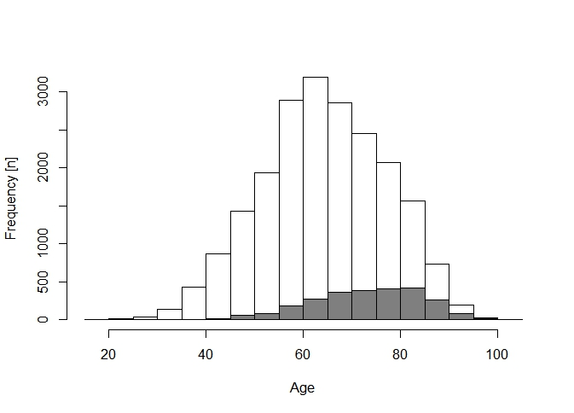
¹
Modelling in evidence-based medicine
National Network Logo
Industrial Sector
Industrial Challenge
Challenges & Goals
• To compare traditional statistical tools with machine learning
• In predicting survival after infarction
• To select the best approach
• To maximize performance
• To compare the philosophically different approaches
Distribution of ages and performance of a classifier

Slide 3
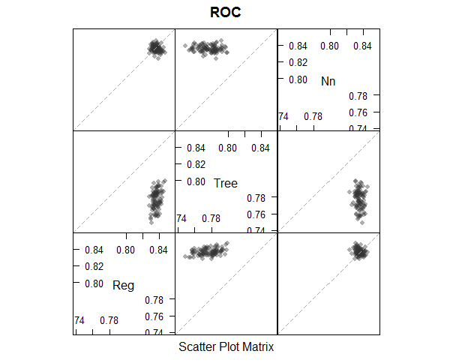
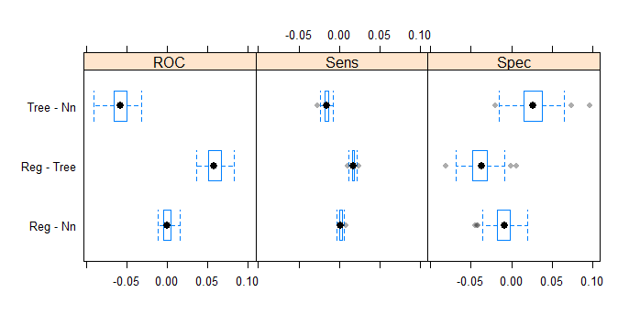
Modelling in evidence-based medicine
National Network Logo
Mathematical and computational methods and techniques applied
Three methods were compared in predicting 30-day and 1-year mortality after suffering acute myocardial infarction (heart attack)
The large, nationwide database of the Hungarian Myocardial Infarction Registry (HUMIR) was used, with more than 47,000 patients included
Logistic regression on the one hand, and decision trees and neural networks on the other were used
Difference between methods
Scatterplot of performance metrics

Slide 4
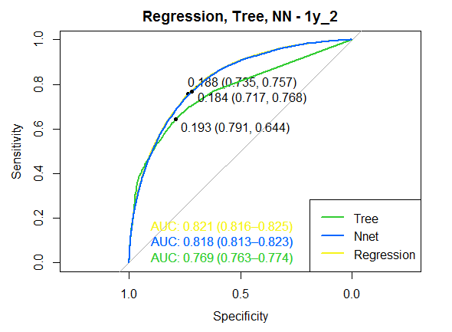
Modelling in evidence-based medicine
National Network Logo
Results & Benefits to the company
Results
. Machine learning methods couldn’t outperform logistic regression
. Neural network was on par with regression
. They both outperformed decision trees
Benefits
. Results that can guide researchers in optimal selection of prediction tools
. General knowledge on how traditional tools compare to machine learning solution
Detailed performance comparison
Digital
Twin
Information is obtained on how to statistically predict survival after infarction to achieve the best performance.

