Slide 1
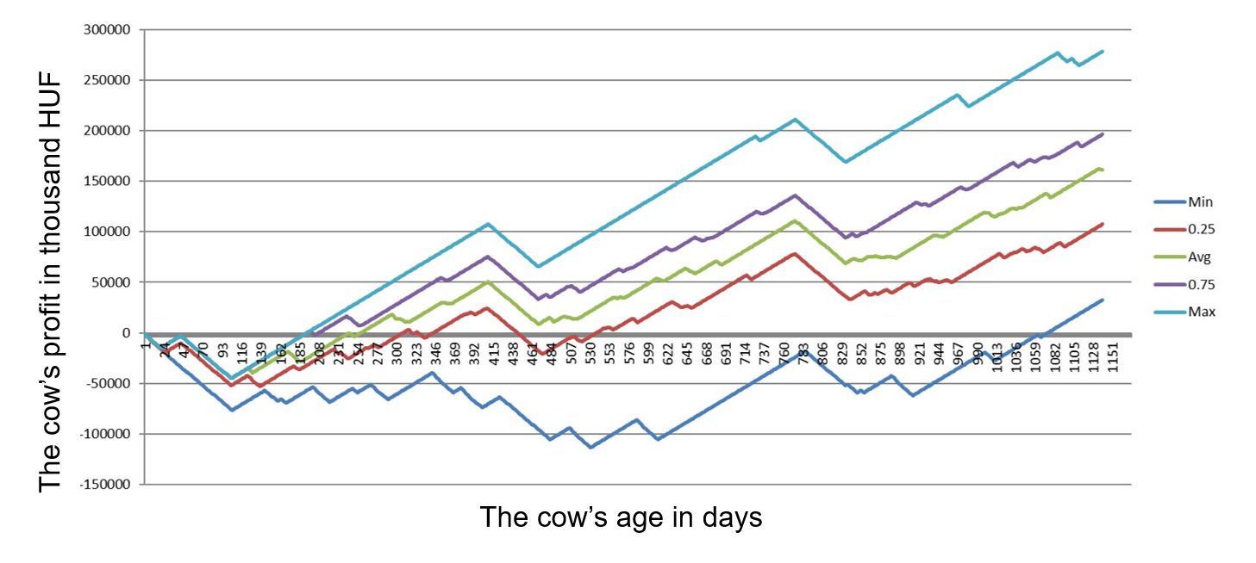
Stochastic optimization of the simulated life-cycle of ill cows to provide an advice for farmers when to sell
H2020 SOCIETAL CHALLENGES: sustainable agriculture systems
Problem description
In Hungary hundreds of thousands of cows produce milk for us. A common disease of them is mastitis, that influences their productivity and profitability substantially. The usual practice is to decide on a rule of thumb basis whether the ill cow should be kept or sold. E.g. they are kept till the fifth mastitis case occurs. We have investigated this problem from a mathematical modelling point of view.
PRODUCTIVE SECTOR: livestock
MATHEMATICAL AND COMPUTATIONAL METHODS
Having a model for the financial description for a cow, we simulate 100 times the possible outcome to have an approximate stochastic description of the distribution function of the profit. Then we can determine an optimal decision on the expected achievable profit whit microsimulation approach.
ChallengeS
and goals
We applying local data instead of the countrywide averages. The research demonstrates the advantages of a recommendation system like program that uses microsimulation and optimization techniques to obtain a well based decision.
Profit values of a cow

Slide 2
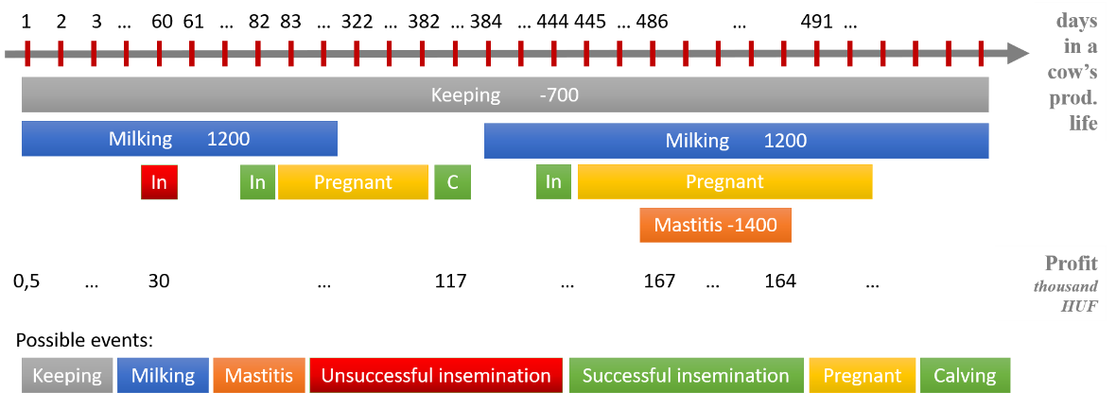
Results and Benefits
Stochastic optimization of the simulated life-cycle of ill cows to provide an advice for farmers when to sell
We have added a labeling technique to our simulation model. It allows us handling several events happening at the same time. For example while the cow is pregnant it can get ill, and it will have mastitis meanwhile it is giving milk. Using this method by summarizing the daily income and outcoming we can get the profit values day-by-day. Also implementing and using new labels is quick and easy, so the model is easily extendable. And last but not least mostly similar but different events can exist at the same time, we only have to chose which one we would like to use in our model.
By using our simulations, we can predict the future of a cow
Digital
Twin
Puskin tej Kft.
HU-MATHS-IN
Puskin tej Kft.

