Slide 1
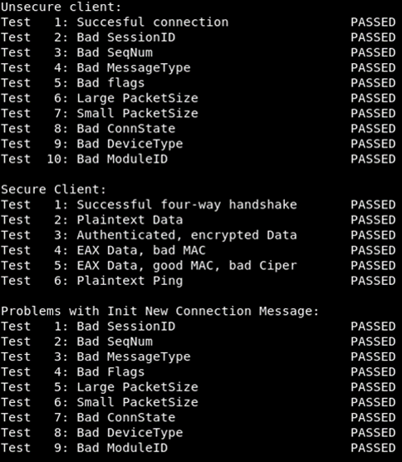
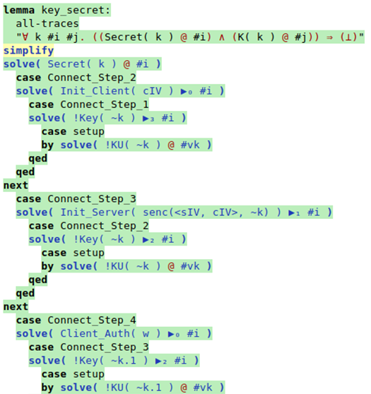
Formal Modeling and Proving Cryptographic Properties of the Optin Sensor Protocol
H2020 SOCIETAL CHALLENGES: secure communicating systems
PRODUCTIVE SECTOR: automobile, health care
Problem description
In this project aided with automatic theorem proving we developed a lightweight cryptographic extension of the Optin Sensor Protocol which heavily used at our industrial partner in IoT devices.
MATHEMATICAL AND COMPUTATIONAL METHODS
For validation of the new protocol version mathematical modeling, namely automatic theorm prooving was used. We modeled both the new protocol design and the security requirements by logic formulas. We used the TAMARIN-Proover software for formal verification of the key security properties.
ChallengeS
and goals
We determinedd the security requirements for some typical industrial use of the OSP protocol, then extended the protocol with cryptography. We also analyzed the security properties of the new extension, and implemented and tested the new protocol features. Moreover, we validated the new design by mathematical modeling and published the new protocol version
Testing and verification of the new design

Slide 2
Results and Benefits
Formal Modeling and Proving Cryptographic Properties of the Optin Sensor Protocol
The new and more secure design of the OSP 2.0 is in use in several ongoing projects and further applications of the protocol are planned.
The new public standard encourages wider both acemic--industrial and industrial—industrial cooperation.
Cryptographic and mathematical modeling insights are beneficial for the system engineers of the company
The new OSP 2.0 protocol standard is available for download from the website of the company: http://www.optin.hu/static/www/ OSP_spec_v2_en.pdf
Digital
Twin
HU-MATHS-IN
OPTIN Kft.

