Slide 1
Lane modelling algorithm
for video-based ADAS
National Network Logo
H2020 SOCIETAL CHALLENGES
Include the more appropriated challenge
The Industrial Problem
Robert Bosch Kft was interested in a dynamic process for ADAS (Advanced driver assistance systems), which computes the lanes continuously and directly from the data of a stereo-camera and giving a lane model based on only these data.
University of Szeged
Research group
Graph theory, discrete geometry, statistics, computer-aided modelling, algorithms, machine learning, programming, psychology.
Robert Bosch Kft.
The Bosch Group is a leading global supplier of technology and services.
Company

Slide 2
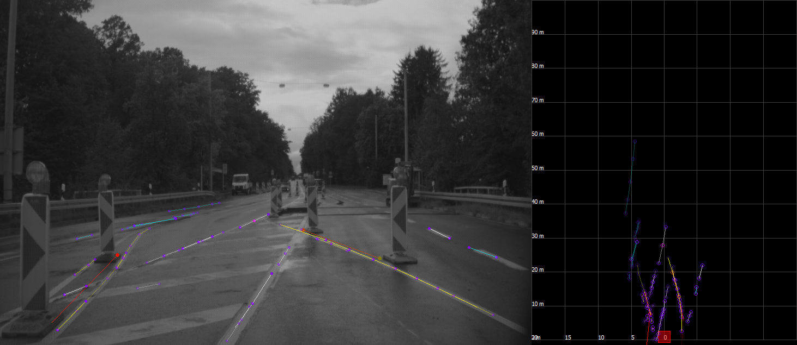
¹
Lane modelling algorithm
for video-based ADAS
National Network Logo
Challenges & Goals
• To identify all possible lanes in the data images
• To implement in embedded framework
• To guarantee small computing capacity
• To optimize the consistency of the lane model

Slide 3
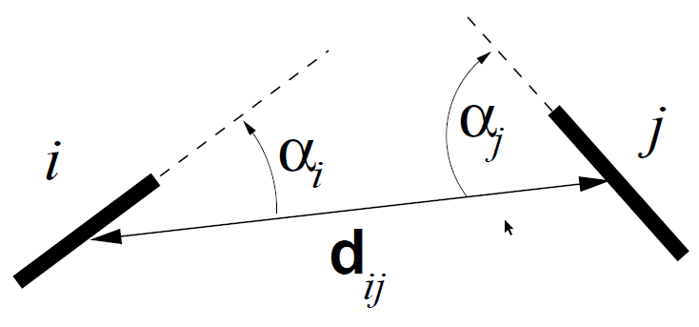
Lane modelling algorithm
for video-based ADAS
National Network Logo
Mathematical and computational methods and techniques applied
Probabilistic grouping fields (handling connectivity of line segments)
Principles of Gestalt psychology
Graph theory (modelling the similarity)
Clustering methods: threshold method and spectral clustering
Parameters for similarity of segments

Slide 4
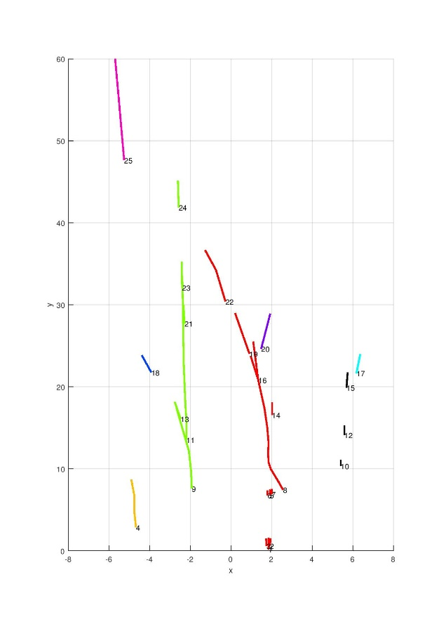
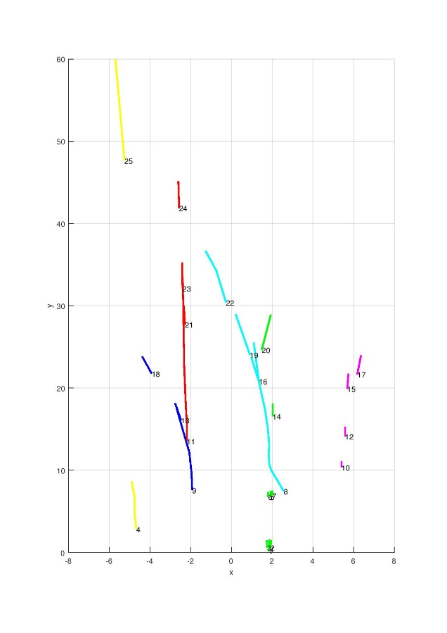
Lane modelling algorithm
for video-based ADAS
National Network Logo
Results & Benefits to the company
Threshold method:
Easy to implement
Efficient runtime
Number of clusters are computed automatically and dynamically
Loss of information
Spectral clustering:
More info is used
#Clusters is input
These algorithms can be combined.
Result of Algo #1 and Algo #2
Digital
Twin
The company has efficient clustering algorithms for the lane model problem.

