Slide 1



A novel psychiatric registry
  A system and its utilization
  for clinical and pharmaceutical research
The Industrial Problem
There has been a growing demand to create patient registries where the collected patient data is readily applicable for statistical analysis and data mining using and advanced methods, like machine learning.
University of Szeged | Many years of experience in mathematical modelling, advanced statistics, machine learning, and software development. strong experience clinical aspects of clinical research medical documentation systems, long-term genetic and epidemiological research
Research group
Takeda Pharmaceutical Company | A patient-focused, innovation-driven global pharmaceutical company, has a focused, world-class R&D innovation engine, making an impact on patients' lives by translating science into life-changing medicines
Company

Slide 2
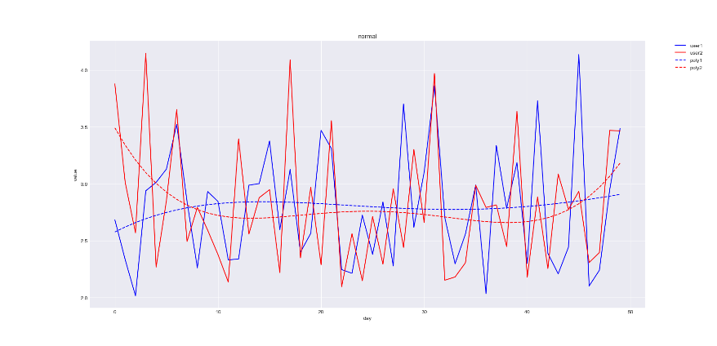
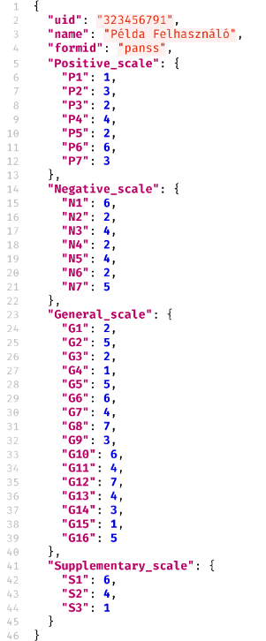


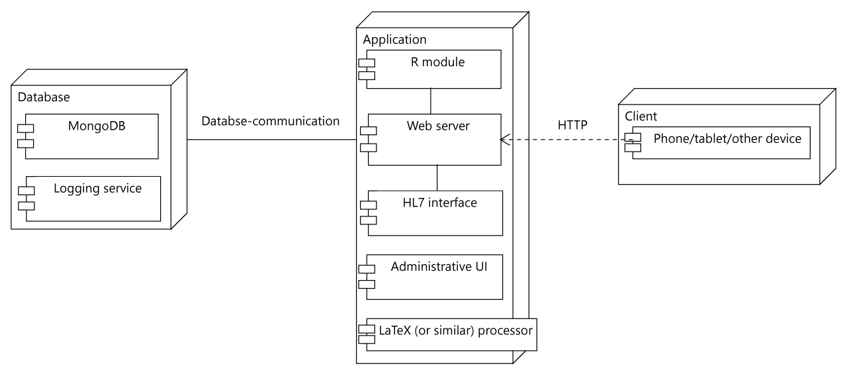
A novel psychiatric registry
  A system and its utilization
  for clinical and pharmaceutical research
Challenges & Goals
Provide a possible solution though the integration of patient registries with the standard EHR patient administration systems.
Apply novel data mining and machine learning techniques to investigate the connection of drug medication with the positive and negative symptoms of psychiatric patients.
Architecture of the registry (left) and example for collected data (above)

Slide 3
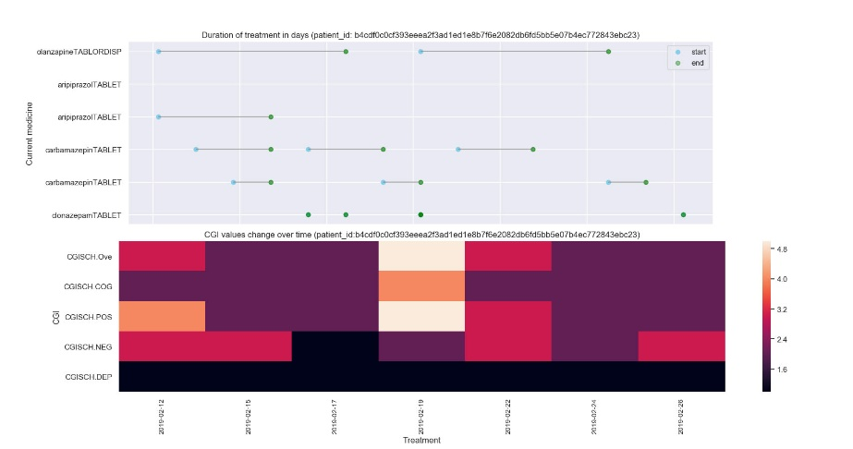
A novel psychiatric registry
  A system and its utilization
  for clinical and pharmaceutical research
Mathematical and computational methods and techniques applied
Data collected in the registry (2 month study):
PANSS (medical scale used to measure symptom severity of schizophrenic patients)
  CGI (measures illness severity (CGIS), global improvement or change (CGIC) and therapeutic response)
  Medication (Previous drug history and medication during hospitalization)
  Demographic data
  Methods:
  Patient classification (Random forest, XGBoost)
  Correlation analysis
  Longitudinal analysis
Variable / forms | Number of records
Patients | 40
Demographic data | 40
Previous medication (antipsychotics) | 21
Progress notes (CGI, medication/dose changes, etc.) | 23
PANSS | 39
Treatment vs CGI – correlation and longitudinal analytics
Some details of collected data

Slide 4
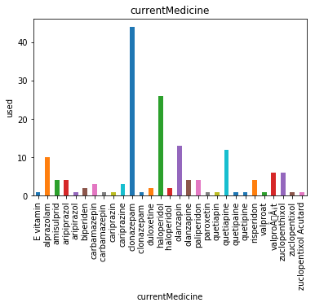
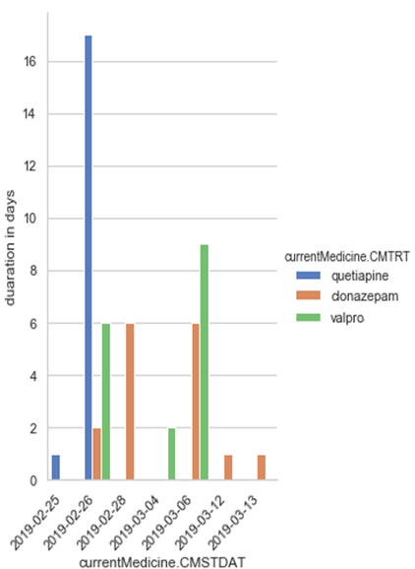




A novel psychiatric registry
  A system and its utilization
  for clinical and pharmaceutical research
Results & Benefits to the company
A novel, easy-to-use registry database (with EHR integration -- in progress)
Potential of significant cost and time reduction in clinical trials
High potential of post-marketing clinical follow up studies
More accurate drug utilization data and its statistical analysis
Medication usage (right) and medication duration (left)
A novel, easy-to-use registry database and potential of significant cost and time reduction in clinical trials for the Company
Digital
Twin

