Slide 1
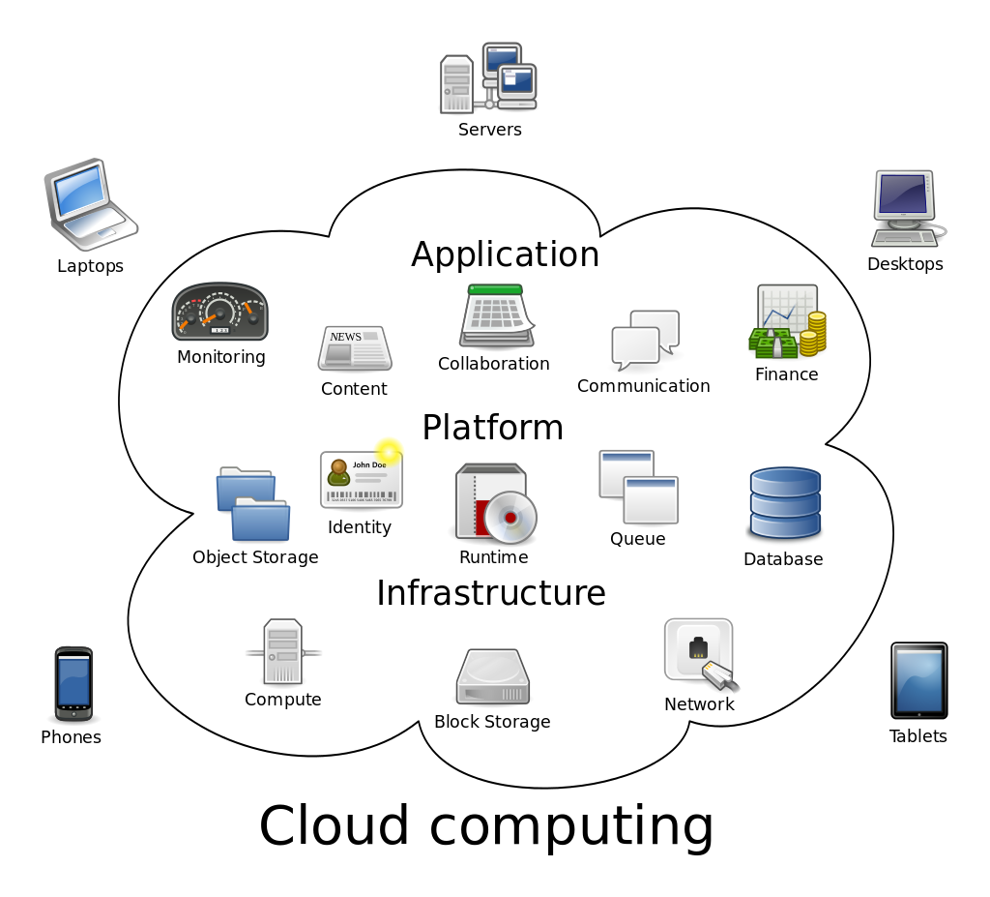
Securing Cloud Authentication
Design and analysis of a distributed authentication protocol for cloud services
H2020 SOCIETAL CHALLENGES: Secure societies – Protecting freedom and security of Europe and its citizens
Problem description
Cloud computing is becoming more and more important in the field of information technology, which faces many security challenges. It is of utmost importance that customers’ confidential data stored and processed in the cloud be protected by a secure user authentication protocol which restricts unauthorized access to the servers.
PRODUCTIVE SECTOR: IT sector, Cloud Service Providers, Small and Medium Enterprises
MATHEMATICAL AND COMPUTATIONAL METHODS
Design of an advanced key exchange cryptographic protocol according to well-established principles. The protocol is analyzed according to the extended Bellare-Rogaway model. A complexity theoretic reduction is given which turns an adversary against the protocol into an adversary against a cryptographic primitive.
Java implementation is created and test it on Microsoft Azure environment.
Challenges
and goals
To guarantee strong entity authentication for clouds and provide robustness and scalability.
To minimize computational costs by applying fast cryptographic operations.

Slide 2
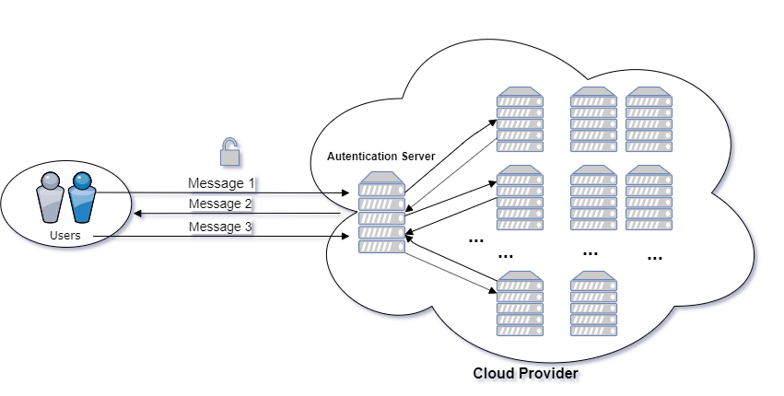
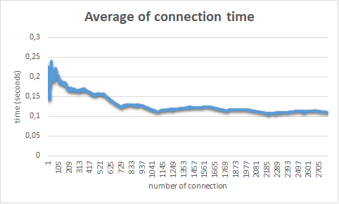
Results and Benefits
Securing Cloud Authentication
Design and analysis of a distributed authentication protocol for cloud services
A mutual entity authentication protocol with key agreement is given where identity verification is carried out by multiple servers applying secret sharing technology on server side. The protocol is provably secure in the threshold hybrid corruption model.
The company has a multi-server mutual entity authentication system for clouds. Even if one or more servers are compromised or break down, the service provider will be able to service and authenticate the users securely.
Authentication protocol for cloud
Digital
Efficiency analysis of implementation
Twin
COMPANY NAME LOGO
University of Debrecen
CCLAB

