Slide 1
MEDICAL DECISION SUPPORT SYSTEM OPTIMIZATION
National Network Logo
H2020 SOCIETAL CHALLENGES
The Industrial Problem
Sightspot Network Ltd. (Hungary) was interested in optimizing the components of image processing-based medical decision support systems to improve their efficiency and accuracy.
Industrial Mathematics
Studying industrial problems using mathematical tools with emphasis on medical decision support and automotive developments.
Research group
Sightspot Network Ltd.
SME that develops mobile applications and special purpose software solutions.
Company

Slide 2
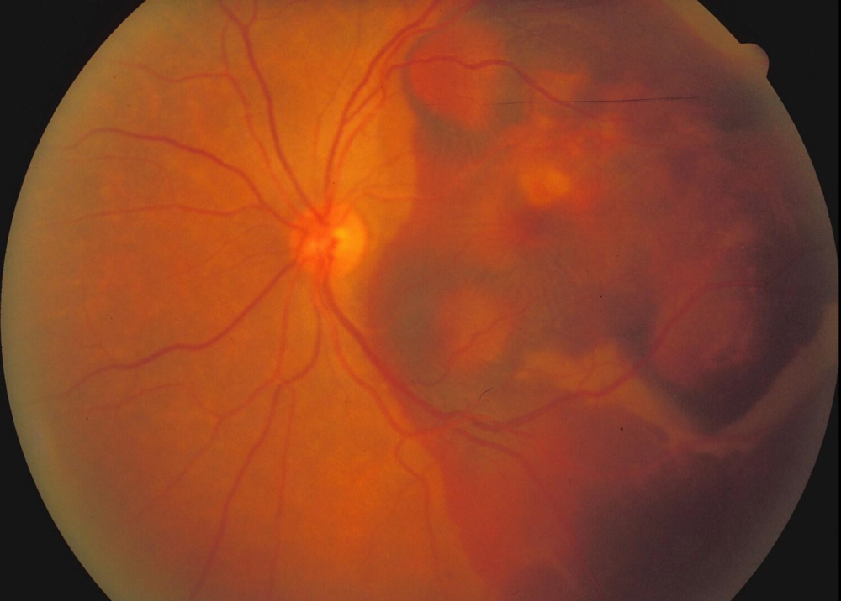
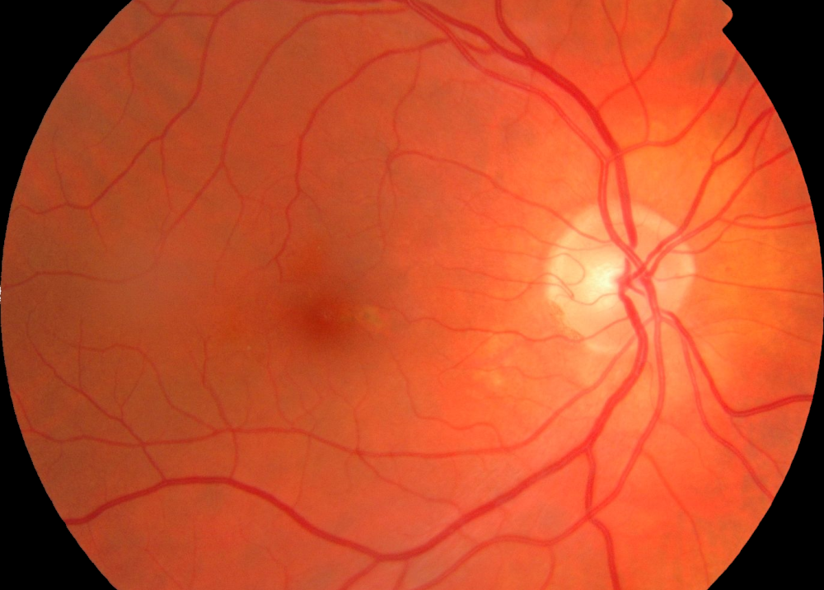
¹
MEDICAL DECISION SUPPORT SYSTEM OPTIMIZATION
National Network Logo
Industrial Sector
Industrial Challenge
Challenges & Goals
• To select the optimal components of image processing-based DSS systems.
• To optimize the parameters of the selected components.
• To improve the accuracy of the decision support.
• To reduce cost and running time of the whole system.
Example application: recognition of age-releated macular degenartion (normal (left) and diseased (right))

Slide 3
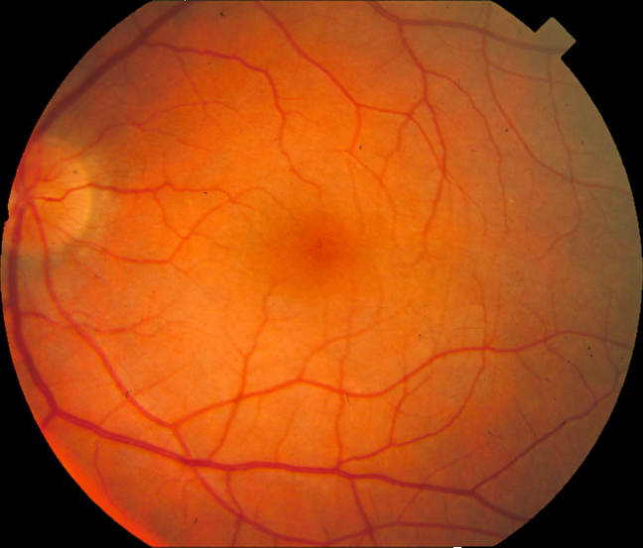
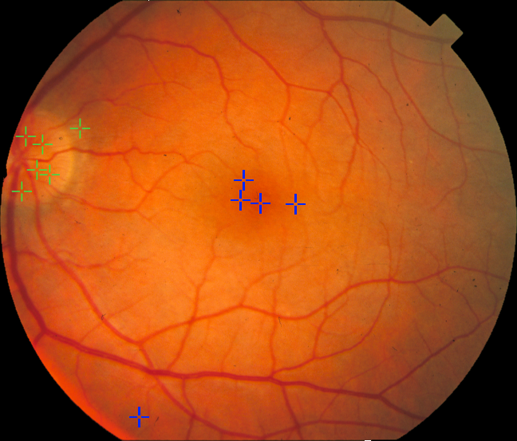
MEDICAL DECISION SUPPORT SYSTEM OPTIMIZATION
National Network Logo
Mathematical and computational methods and techniques applied
Mathematical characterization of composite image processing-base medical decision support systems having the highest performance under an additional constraint on the total cost (e.g., running time).
Stochastic optimization for the selection of the member algorithms and their parameter settings that maximizes accuracy considering large image training data sets and cost constraints.
Input retinal image
Automatic optic disc (green) and macula (blue) center candidates

Slide 4
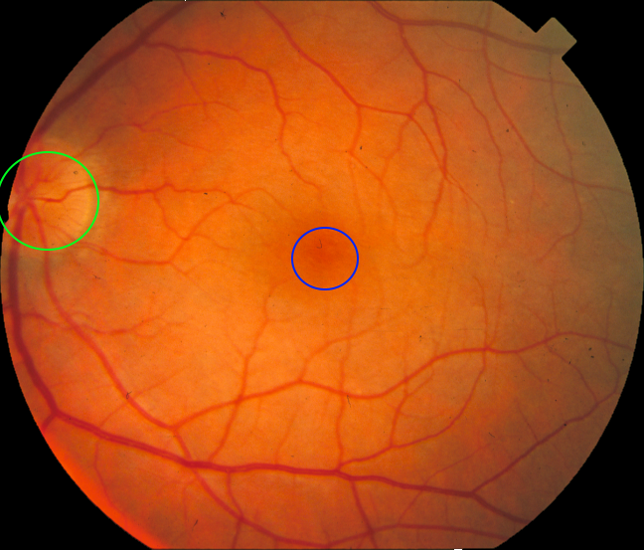
MEDICAL DECISION SUPPORT SYSTEM OPTIMIZATION
National Network Logo
Results & Benefits to the company
A preliminary strategy to select and fine-tune the components of different image processing-based medical decision support systems.
Sample output of the optimized system
The company has a methodology to optimize image processing systems considering different cost constraints.

