Slide 1
Optimal cutting and packing of the supporting rubber parts
H2020 SOCIETAL CHALLENGES: Productivity, efficiency
Problem description
The production in the motivating firm is highly automatized, basically the only slow, human workforce heavy part of the workflow is the design, cutting and placing of the rubber parts supporting the cutting blades. Since the company is interested in timely delivery, they want to establish an edge in delivery times compared to their rivals in the country. Now this phase of the work requires a few hours of human work, and with the present tools it is often error prone, and it requires a restart, and mean unnecessary lost time..
PRODUCTIVE SECTOR: manufacturing process
MATHEMATICAL AND COMPUTATIONAL METHODS
On the abstraction of splitting and merging algorithms, we build the cutting and gluing algorithm. For the optimal packing, we construct a penalty function for pieces to determine the best glue. The result pieces we layout with GA based nesting algorithm.
Optimal splitting:
- Easy manufacture process
Optimal layout:
- Minimize material consumption
ChallengeS
and goals
Our goal is to speed up and automate the design process the development of a software to automate the rubber splitting and layout processes
Computing time:
- Minimize overall processing time
The main problems in
the productivity.

Slide 2
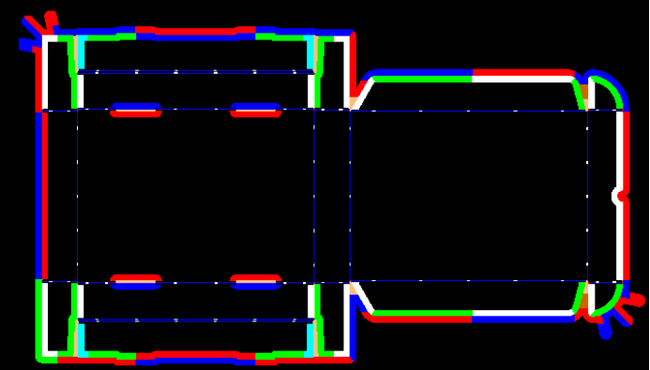
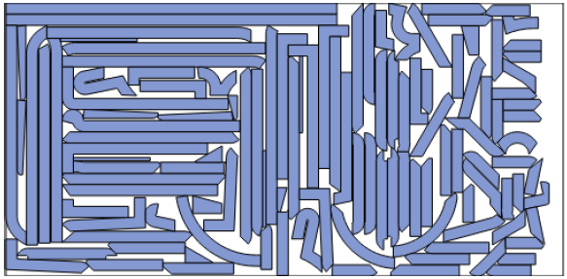
Results and Benefits
Optimal cutting and packing of the supporting rubber parts
We developed an application that is capable of processing significant steps of the fabrication process automatically
Data import from the CAD files is implemented
Splitting of the rubber parts is functioning
Data export for the nesting algorithm is implemented
Optimization of the layout is functioning
Export of the layout is implemented
Exporting the resulting layout in CAD format
Instead of 250 minutes human processing time for one day replaced about 50 minutes CPU time with proposed algorithm.
Splitting plan
The optimal layout
Digital
Twin
HU-MATHS-IN
Stancforma Ltd.

