Slide 1
MONITORING and COST OPTIMISATION in HEALTHCARE by MARKOV CHAIN METHODS
H2020 SOCIETAL CHALLENGES: Monitoring and cost optimisation
PRODUCTIVE SECTOR: Healthcare and health-economics
Problem description
Consulting companies in healthcare and health-economics have to find cost efficient therapies and therapeutic regimens and to compare them. These challenges also emerged and need to be solved at the Healthware Consulting Ltd., Budapest.
MATHEMATICAL AND COMPUTATIONAL METHODS
The main methods and the connected problems are as follows:
• Incorporation of transition probabilities into a Markov chain’s transition matrix which represents the state of the patient at the sampling times (i.e. control visits)
• Calculation and optimisation of costs using the stationary distribution of the Markov chain
• Usage of a gamma deterioration process for disease progression
• Accurate simulation of disease progression
All of these methods required the development of new theoretical results (such as the estimation of costs between control visits) as well as extensive programming C++ and R. This meant the creation of new, purpose-built functions.
ChallengeS
and goals
• To develop cost-optimisation methods, which are applicable to medical processes
• To incorporate random degradation, random treatment effectiveness and patient incompliance
• To model and simulate chronic disease progression
• To correct of the lead time bias
Disease progression-treatment cycles

Slide 2
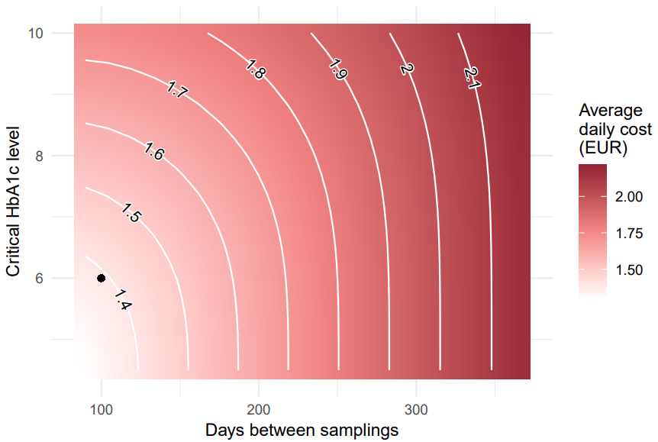
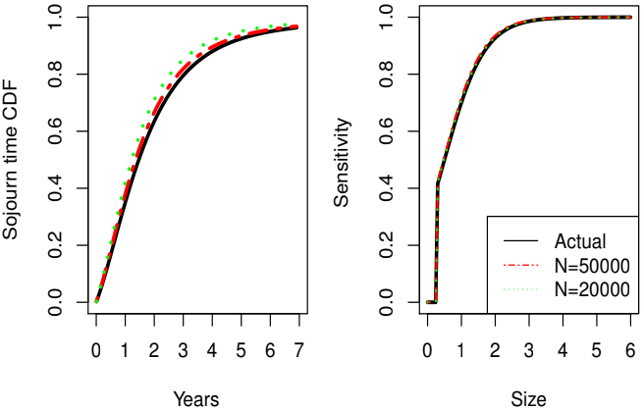
Results and Benefits
MONITORING and COST OPTIMISATION in HEALTHCARE by MARKOV CHAIN METHODS
The most important practical results include the cost estimation in different treatment regimens and more accurate estimation of the lead time bias. The results were presented at several conferences, at a webinar and two published papers, while a third paper has also been submitted. The control chart method was successfully applied to real-world medical data at the Healthware Consulting Ltd. and a preliminary analysis using the method was sent to a client, which may be followed by further research using the model.
The company has R programs to estimate and optimise costs related to illness progression and treatment
Relationship of the parameters and the daily average costs. (The dot corresponds to the optimal parameters fitting the empirical data).
Our approach leads to more accurate estimators for the process parameters,
even if based on a much smaller sample size
Digital
Twin
Research Group for developing Markov-chain methods in monitoring health-care processes
Hungarian Service Network for Mathematics in Industry and Innovations
ELTE
Healthware Consulting Ltd.

