Slide 1
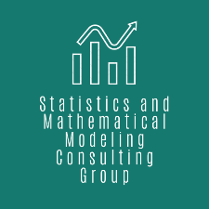
PREDICTION and FACTORS
of DROPOUT in HIGHER EDUCATION
The Industrial Problem
Every third student drops out from undergraduate programs, that is associated with social and economic costs. The shortage of skilled human resources endangers the outlook of economic growth. The goal is to predict final academic performance and identify its contributing factors.
Statistics and Mathematical Modeling Consulting Group | Offers statistical consulting and provides data science research and development service to corporate and academic partners.
Research group
SDA Informatika Zrt. | Among other things, SDA develops the educational administrative system of Hungarian universities.
Company

Slide 2
PREDICTION and FACTORS
of DROPOUT in HIGHER EDUCATION
Challenges & Goals
To predict the final academic performance based on pre-enrollment achievement measures.
To identify the contributing factors of university success.
To show how and what to extent features affect individual predictions of final performance.
To help higher education decision-makers find at-risk students.
To suggest higher education policy-makers action plans for reducing dropout rate.
To help students find the skills they need to master.
Two examples for the prediction of final performance together with the contributing factors

Slide 3
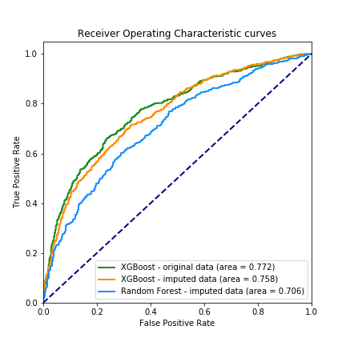
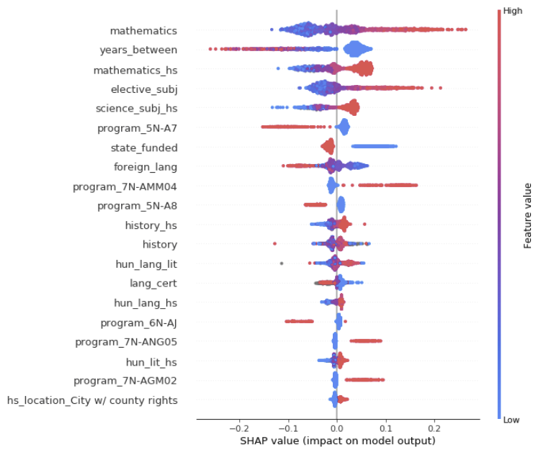
PREDICTION and FACTORS
of DROPOUT in HIGHER EDUCATION
Mathematical and computational methods and techniques applied
Data imputation using multiple imputation by chained equations with Bayesian ridge regression.
Prediction of final academic performance using gradient boosted trees (XGBoost).
Evaluation methods with reciever operating characteristic curve (ROC) analysis.
Local model explanation with SHAP values, based on a game-theoretical concept: Shapley value.
Global model interpretation with permutation importance and aggregated SHAP values.
ROC curves of Xboost and Random Forest models
Summary of the effects on the final performance of the most important features.

Slide 4
PREDICTION and FACTORS
of DROPOUT in HIGHER EDUCATION
Results & Benefits to the company
A developed web application that returns predictions of final academic performance based on some pre-enrollment achievement features. The application also highlights which skills should be improved for a given student.
3 years of successful collaboration on educational research and decision support system development.
Staff and researchers formation: more than 20 publications in prestigious conferences and high impact journals.
User input of the web application
The company is currently deploying our web application into the educational adminsitrative system.

