Slide 1
Application of neural nets and deep learning in clinical screening systems
The Industrial Problem
The planed theoretical investigations are expected to lead to marketable results in clinical decision support/automatic screening systems. The industrial partner wants to develop a reliable self-screening system.
University of Debrecen
Here we list the fields of expertise of the members of the research team as medical image processing, machine learning, graph theory, ensemble systems, neural networks
Research group
SightSpot Network Ltd.
Company
IT company with greate experince in the field of mobile application development.

Slide 2
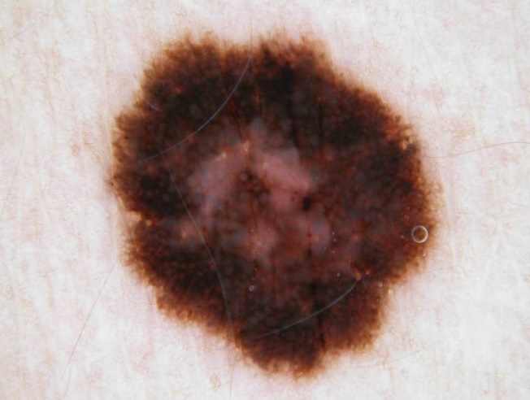
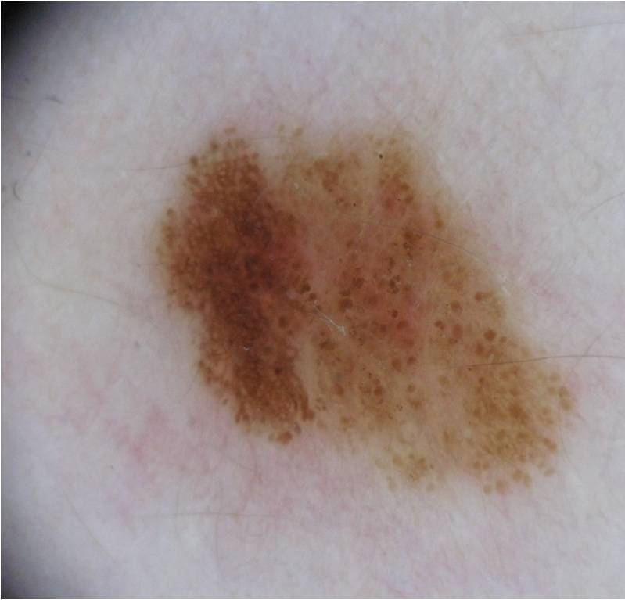
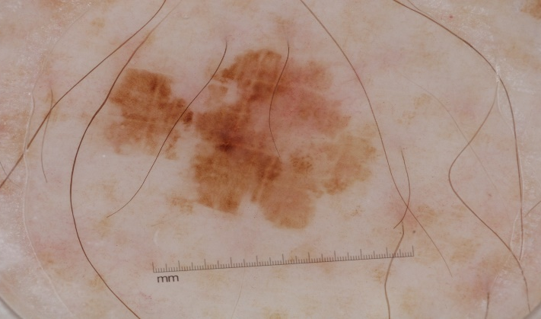
¹
Application of neural nets and deep learning in clinical screening systems
Challenges & Goals
Can a single CNN be used effectively for a given task?
Are the available CNN architectures efficiently applicable for a given task?
Are the learned features reliable?
Would the inclusion of handcrafted (conventional) features improve the performance?
How we can develop efficient methods to classify skin lesion images into three different classes?

Slide 3
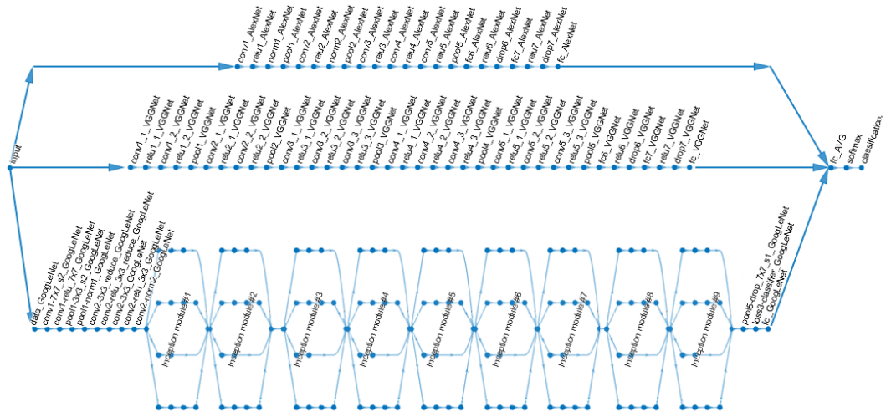
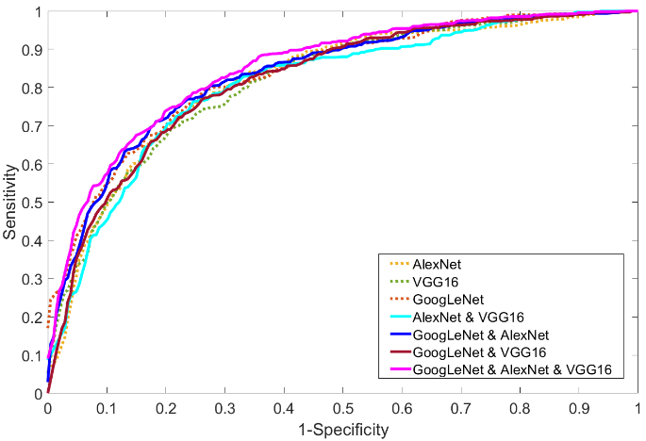
Application of neural nets and deep learning in clinical screening systems
National Network Logo
Mathematical and computational methods and techniques applied
We investigate how we can create an ensemble of CNNs in order to outperform the accuracies of the individual ones.
We work out the theoretical background of the fusion of CNNs in the training stage.
We examine the combination of the features extracted by CNNs and other conventional methods.
We have developed a new loss function to support the ensemble training
Architecture of the ensemble
Perfomances of different ensembles

Slide 4
Application of neural nets and deep learning in clinical screening systems
Results & Benefits to the company
We created an ensemble of deep convolutional neural networks to improve further their individual accuracies
We proposed the aggregation of robust convolutional neural networks (CNNs) into one framework
We considered different fusion-based methods and select the best performing one
The applied fusion strategies outperforms the individual networks regarding classification accuracy.
Screenshoot from the devepoled mobile app.
Digital
Twin
We have developed an automated screening system which is built into a mobile application to provide a self screening tool for the users in the world-wide.

