Slide 1
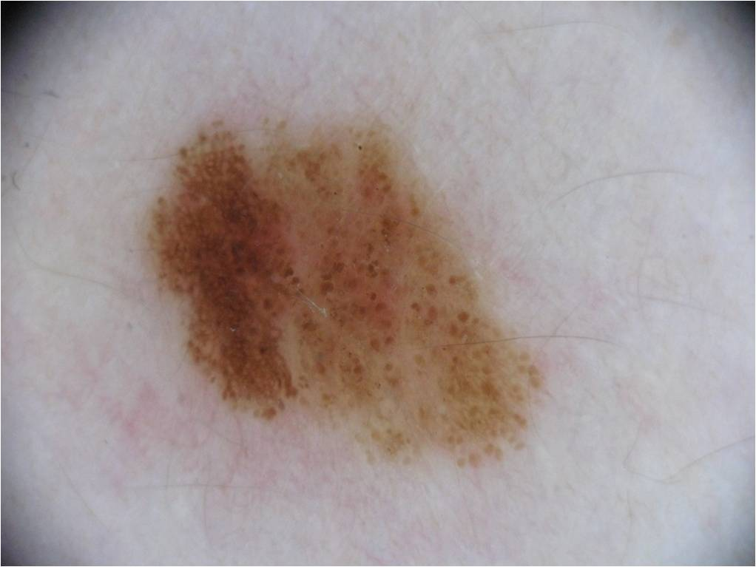
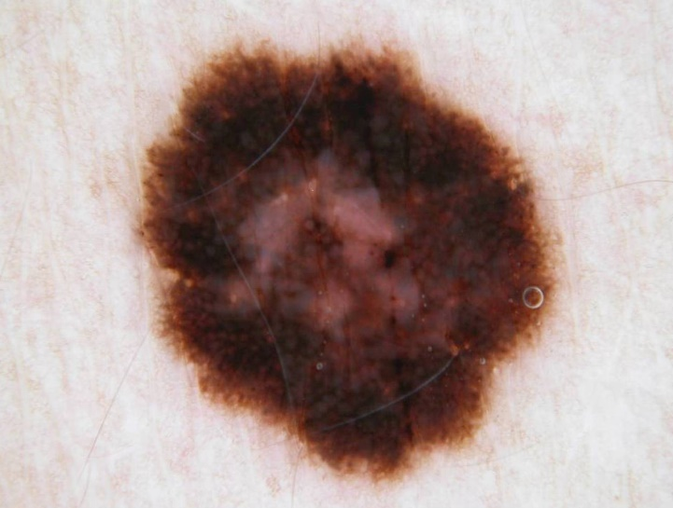
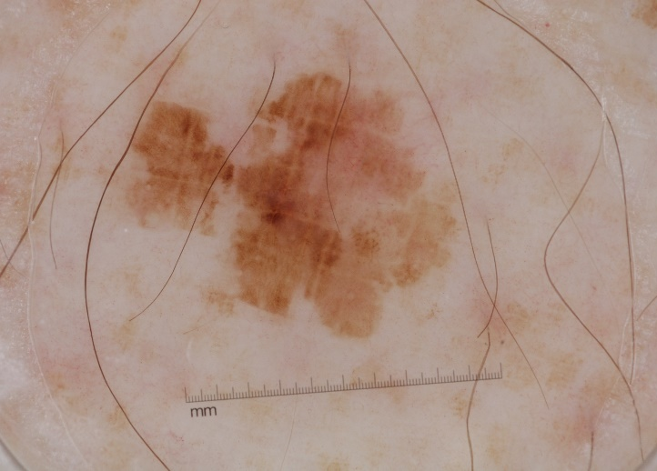
Application of neural nets and deep learning in clinical screening systems
PRODUCTIVE SECTOR: medical sector
Problem description
Theoretical investigation to developing a clinical decision support system using machine learning based algorithms in several fields:
Skin lesion detection
Retinal image analysis
Cytology
MATHEMATICAL AND COMPUTATIONAL METHODS
We will investigate a possibilities about how we can successfully improve the accuracy of CNNs if we could not extend the size of training image set.
We investigate how we can create an ensemble of CNNs in order to outperform the accuracies of the individual ones.
We work out the theoretical background of the fusion of CNNs in the training stage
We examine the combination of the features extracted by CNNs and other conventional methods
ChallengeS
and goals
The planed theoretical investigations are expected to lead to marketable results in clinical decision support/automatic screening systems.

Slide 2
Results and Benefits
CATCHY TITLE OF THE SUCCESS STORY
Include a subtitle of the problem if necessary
We created an ensemble of deep convolutional neural networks to improve further their individual accuracies in the task of classifying dermoscopy images into the three classes melanoma, nevus, and seborrheic keratosis when we have no opportunity to train them on adequate number of annotated images. To achieve high classification accuracy, we fuse the outputs of the classification layers of four different deep neural network architectures. More specifically, we propose the aggregation of robust convolutional neural networks (CNNs) into one framework, where the final classification is achieved based on the weighted output of the member CNNs. For aggregation, we consider different fusion-based methods and select the best performing one for this problem. Our experimental results also prove that the creation of an ensemble of different neural networks is a meaningful approach, since each of the applied fusion strategies outperforms the individual networks regarding classification accuracy.
We have developed an automated screening system which is built into a mobile application to provide a self screening tool for the users in the world-wide.
Digital
Twin
University of Debrecen
SightSpot Network Ltd.

